Slide 1
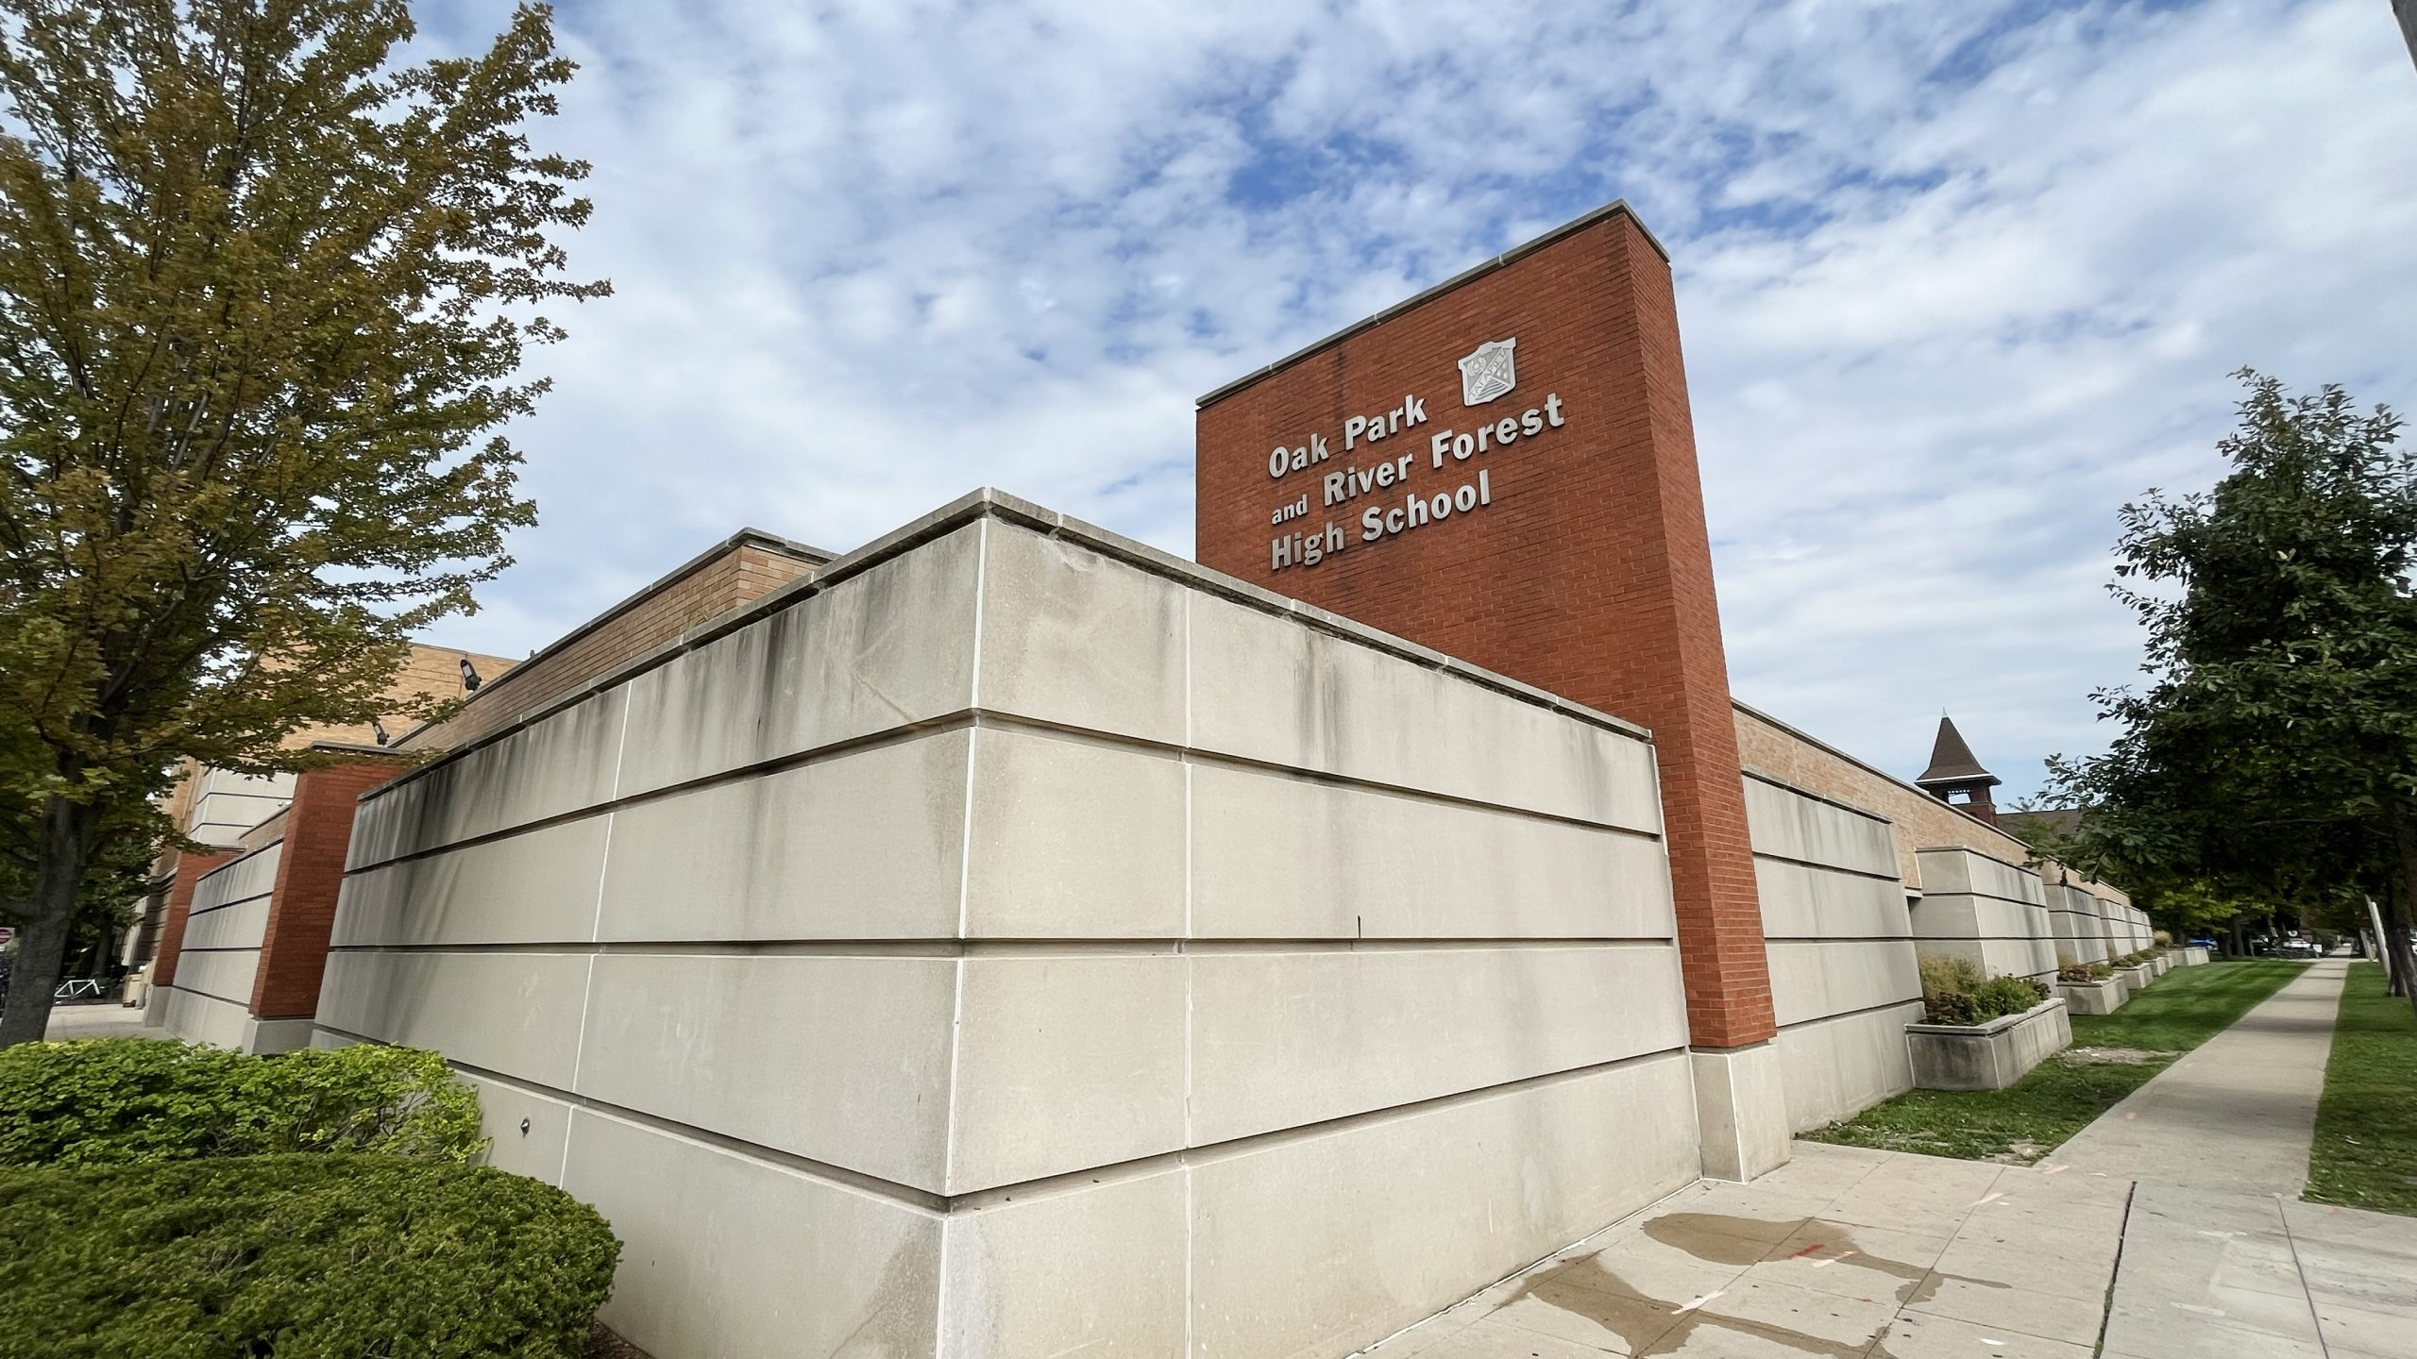
In Loving Memory of Our Classmates
OPRFHS Class of 1994 - Forever in Our Hearts

Slide 2
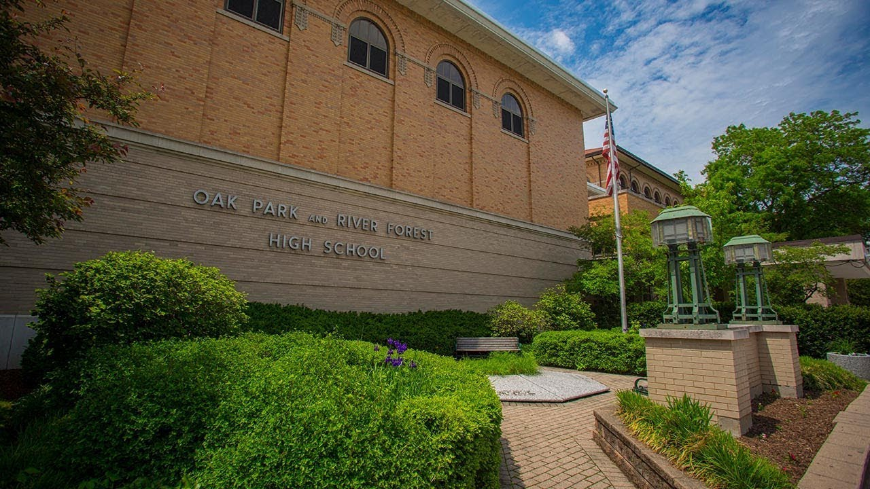
Remembering Their Legacy
Each of these individuals was a special part of our journey, creating memories and shaping our lives.
Today, we also celebrate the joy they brought to us all.

Slide 3
Nicholas
Allabastro

Slide 4
David
Amani

Slide 5
Diana
Bland

Slide 6
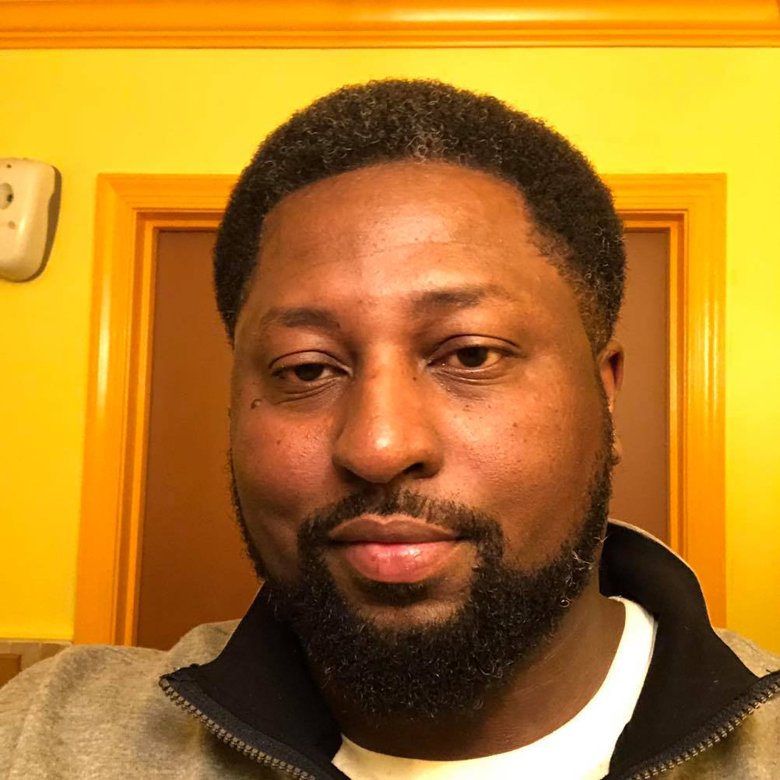
Chris
Brown

Slide 7
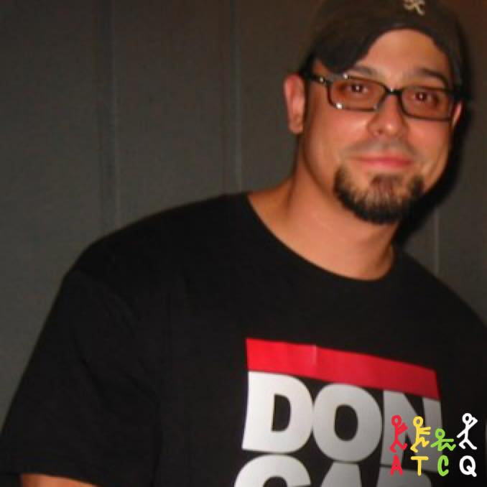
Brett
Cabanas

Slide 8
Joshua
Cheeks

Slide 9
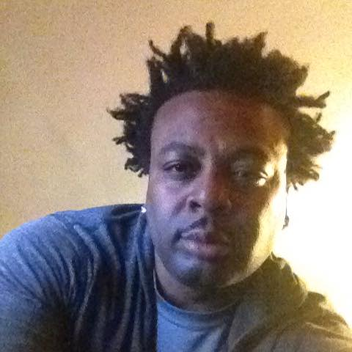
Julian
Clark

Slide 10
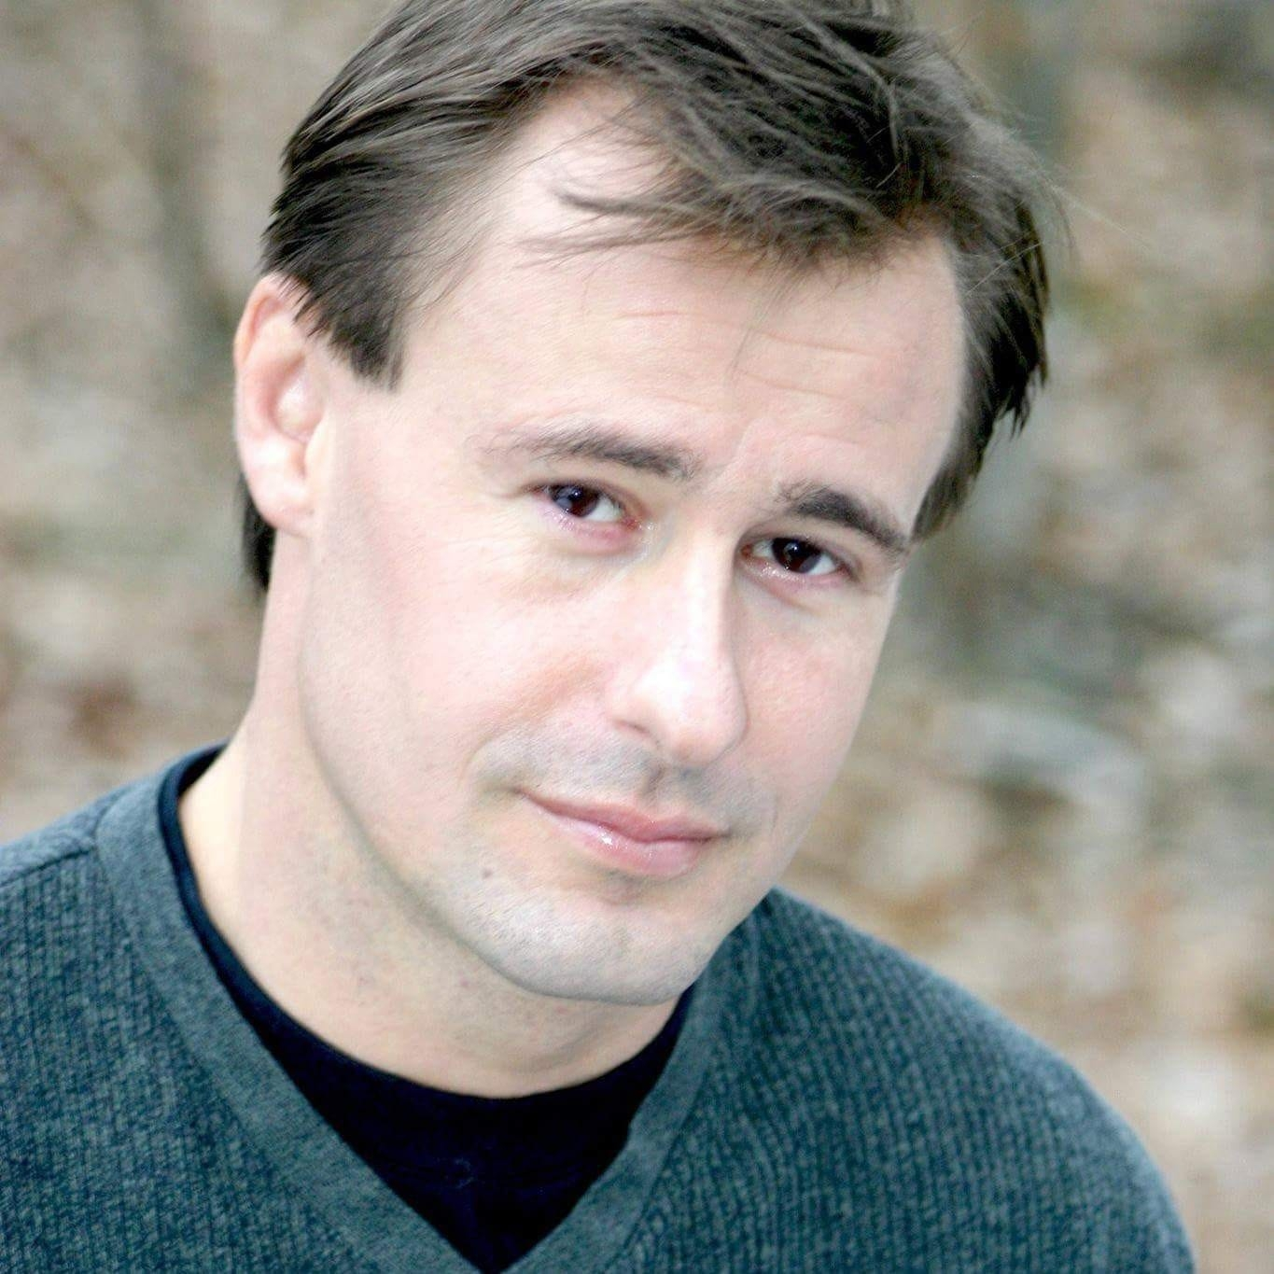
David
Eckberg

Slide 11
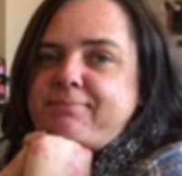
Kelly
Fogg

Slide 12
Andrew
Ghertner

Slide 13
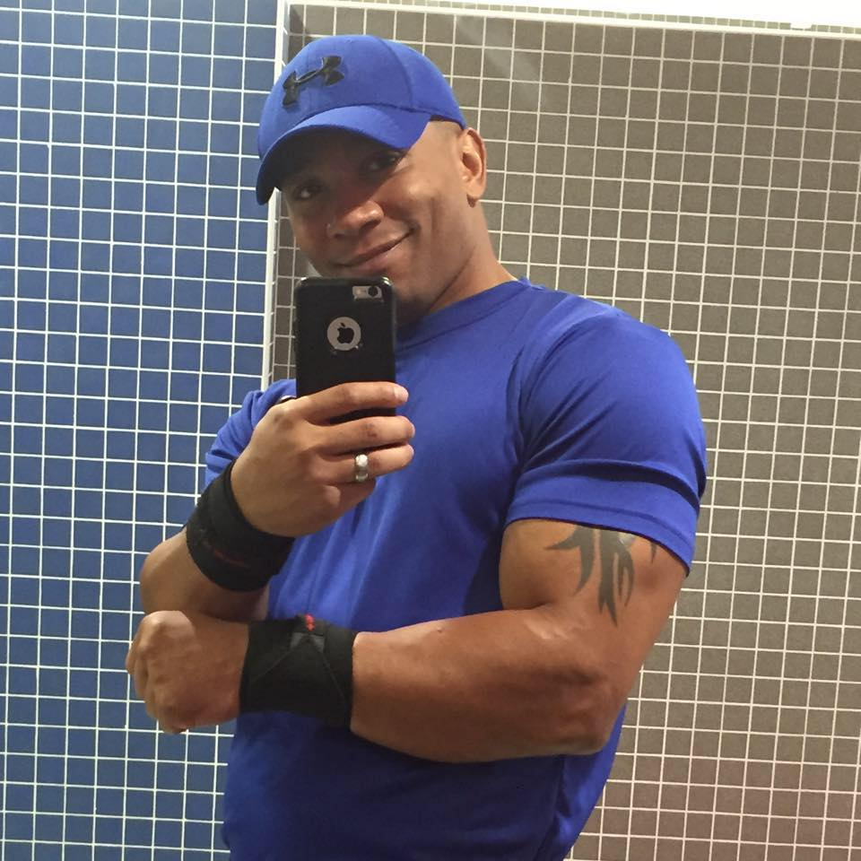
Julian
Gonzalez

Slide 14
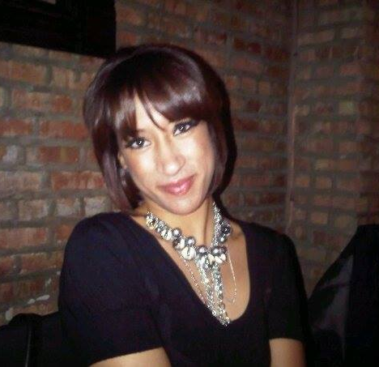
Jenni
Green

Slide 15
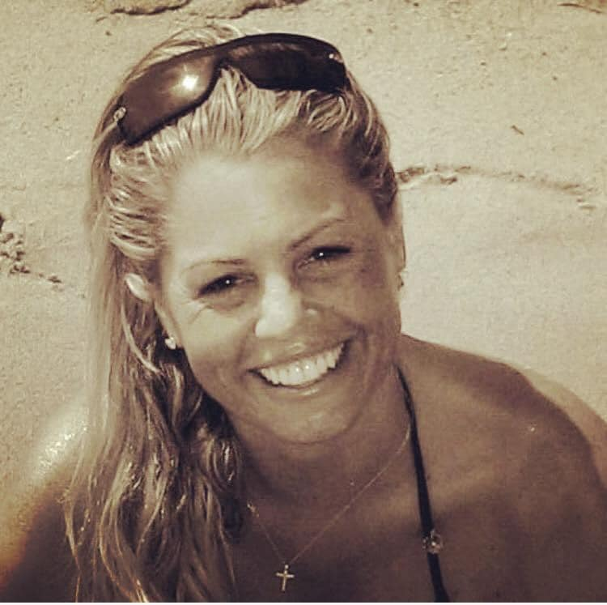
Charlotte
Harrison

Slide 16
Brendan
Hedges

Slide 17
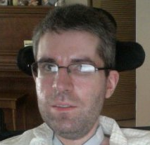
David
Hyde

Slide 18
Langdon
Hutchinson

Slide 19
Joe
Kunkel

Slide 20
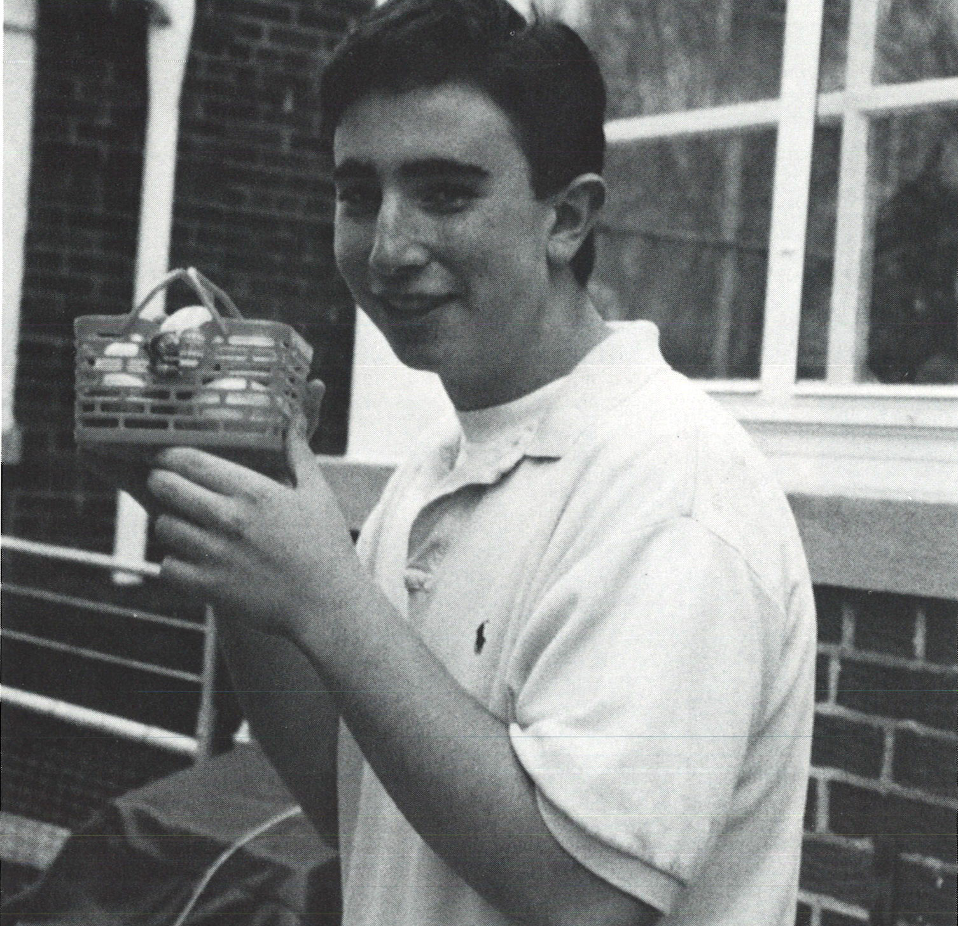
Timothy
Lutz

Slide 21
Janielle
Marcus

Slide 22
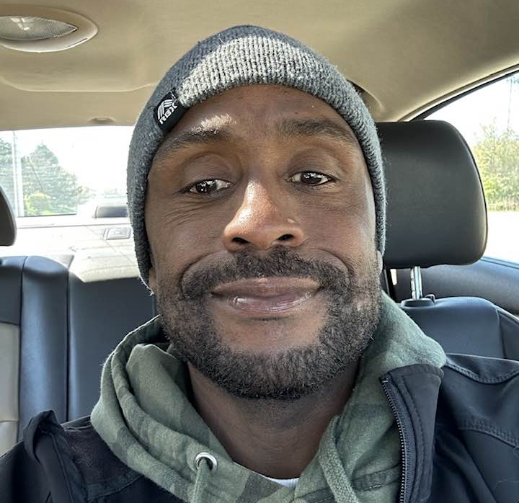
Jeams
Potts

Slide 23
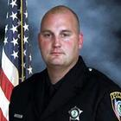
Thomas
Reilly

Slide 24
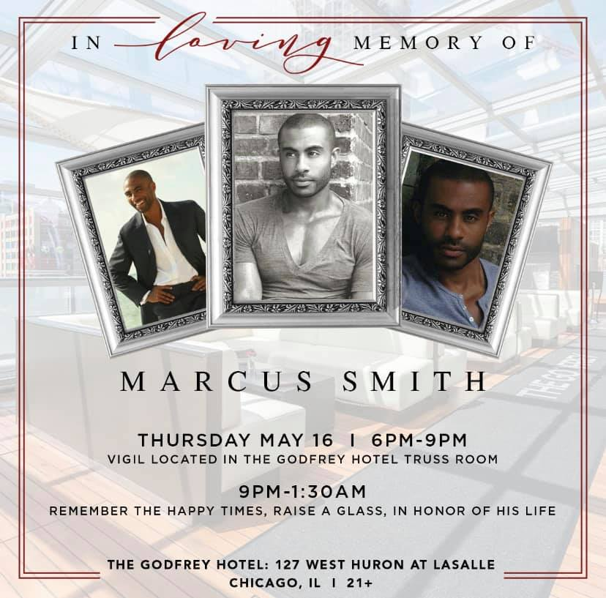
Marcus
Smith

Slide 25
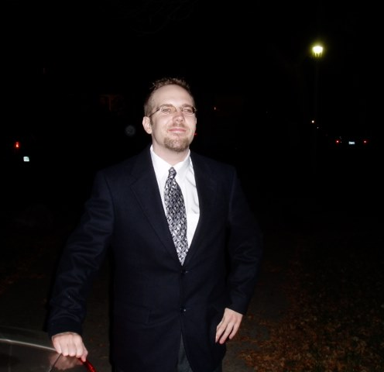
Kevin
Tideman

Slide 26
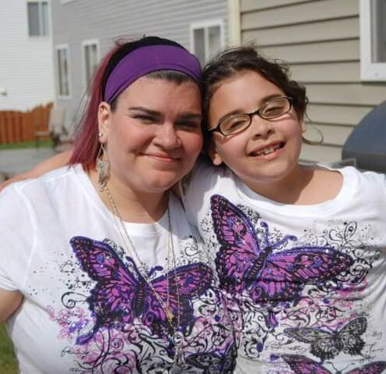
Angelina Goneno-Griffith

Slide 27
Casey
Robinson

Slide 28
Larry
Rossow

Slide 29
Kacy
Towner

Slide 30
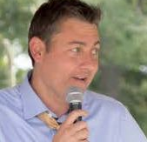
Patrick
Vizzone

Slide 31
Always in Hearts

